Slide 1

Team Galvatron: Content Hub
Vickie Yen, Tony Kong, Yuting Wen, Peter Han, Pengwei Zhou, Tyler Nee, David Guo

Slide 2

GALVANIZE

Slide 3
01
04
Problem
Q&A
02
03
Design
Demo

Slide 4
01
Problem

Slide 5


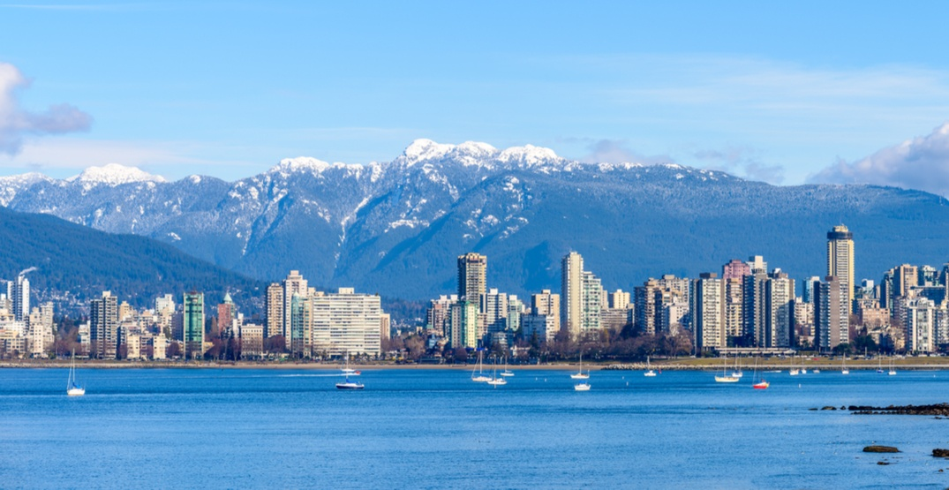





Vancouver Tech Ecosystem

Slide 6
Key Issues
Not Enough Content
Missing Local Community
Less traffic to individual forums & blogs
No central location to share local technical ideas

Slide 7
02
Design

Slide 8
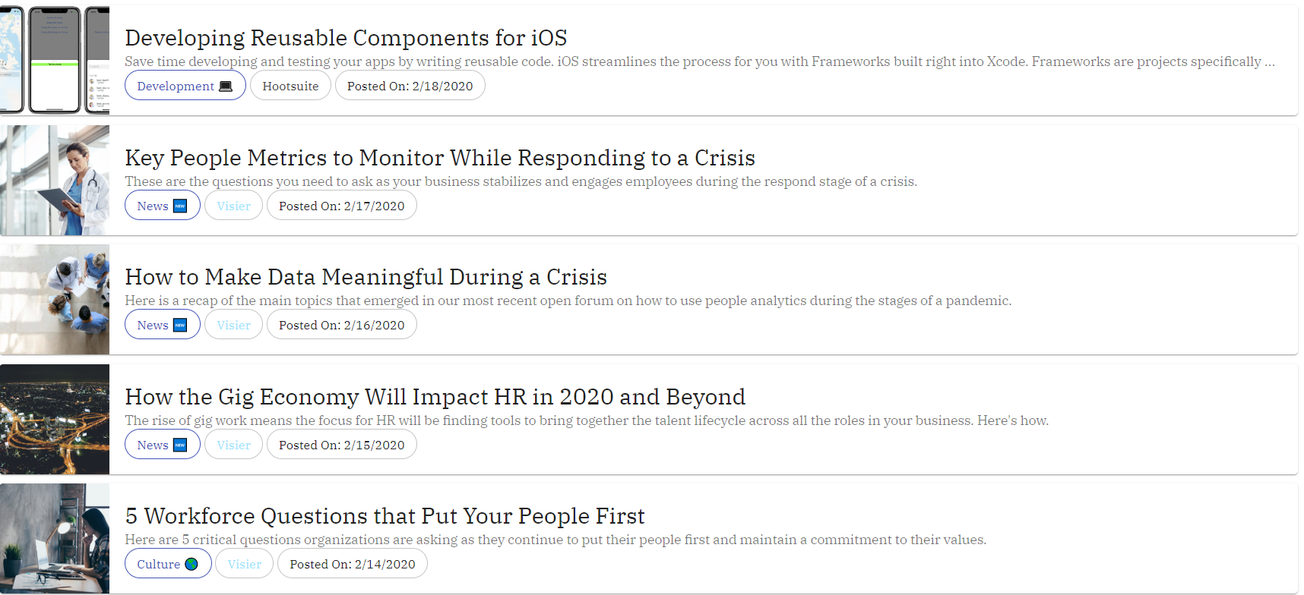
Design
Clean
Welcoming
Easy to Digest

Slide 9
03
Implementation

Slide 10
Content Aggregator: Main Components
Authorization
Scheduler
RSS Feed
Deployment

Slide 11
03
Demo

Slide 12
Meet Jimmy The User
25%
75%
Rock Music
DevOps
Stack Overflow
TechCrunch
Loves rock music and DevOps
Moved here from Sweden
The Verge
Wants to learn about DevOps in Vancouver
Works at a local startup

Slide 13
0.0%
Success rate of finding a local community forum or blog that specifically talks about DevOps in Vancouver

Slide 14
What Jimmy Sees

Slide 15
Meet Hank The Admin
37.5%
62.5%
Dad
Data Science
Stack Overflow
Hacker News
Father of 3 and Big Data Guy
Manager at a small tech firm
T-Net
Vancouverite
Wants to see how others are using data in their company

Slide 16
What Hank Sees

Slide 17
Jimmy Approver

Slide 18
04
Q&A

